Slide 1
Cluster Analysis
AM04 MAM - Data Science for Business
Dr Kanishka Bhattacharya
Notes:
Lt 17
Break times
16:45--16:55
17:45--17:55
16:18:45

Slide 2
Data Science
Clustering
Welcome back to Data Science
Thank you for being early.
Zoom classroom etiquette
Please turn on your cameras and mute your microphone.
Session plan
Part 1: Unsupervised learning and clustering
Use chat when instructed, otherwise please raise your virtual hand if you have questions.
Part 2: K-means clustering
Part 3: Interpreting the results of clustering methods
Mini Workshop
Next 5 sessions I intend to teach from LT including workshops

Slide 3
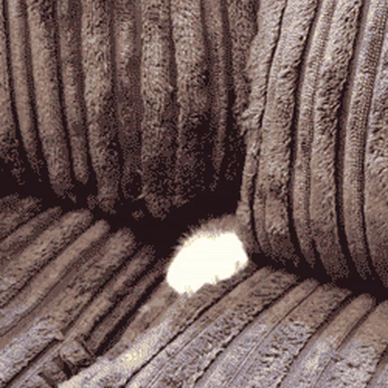
Lectures and assignments
Zoom Etiquette
Turn your camera on, mic off
If your camera is off, you need to explain why that's the case to the facilitator
If you don't have a decent camera, you can find something decent for £10 on eBay.
If you have other unprecented issues email me and explain your situation
If you don’t turn your camera on and do not contact us explaining your situation, I will call on you

Slide 5
Course contents
Session 6:
Session 7:
Assignment 3 (group), due by Tuesday 16th Nov
Session 8:
Nearest neighbors
Tree based learning
Session 9:
Session 10:
Assignment 4 (individual), due in 2 weeks after Session 10: Ensemble Methods
Ensemble methods
Contemporary data mining algorithms
Workshop - Clustering
Unsupervised learning: clustering
Workshop: Case competition

Slide 6
Lectures and assignments
Policies
Late submissions will not be accepted
You should submit your report, and rmd and html files
If your rmd does not knit it means there’s something wrong with it.
We will not grade code that does not run.
No html file=no grade
Answer questions and present your argument clearly
Office hours
Will be announced
Class slides (with notes) and rmd files will be posted on canvas
Plagiarism declaration

Slide 7
How to get the most from this class
Read learning outcomes
Read cases before coming to class
Embedded in html files
Run the code on your own
Try to answer questions in HTML files
Office hours
Make sure to take full advantage
Assignments
Check the rubric to ascertain you understand what is expected
Make sure you can answer all questions at the end of each session
Ask at the end of session if not

Slide 8
How to get the most from this class
Purpose
Algorithm
R implementation
Interpretation of results
Make sure you can answer all questions at the end of each session
Ask at the end of session if not

Slide 9
Assignments
Check the technical writing guide
Check the deadlines
Apply for EC if you cannot complete them on time
How to write technical reports
Simple word template
Technical reports
Guidance
Check learning outcomes for each assignment
Follow instructions where available

Slide 10
Assumed prior knowledge
R coding
Tidyverse
ggplot2
Basic Statistics
Hypothesis testing
Statistical significance
Supervised learning
Difference between classification and prediction
Fitting linear and logistic regression models in R
Interpreting the results of regression models
Out of sample testing (cross validation)
ROCs
Base R

Slide 11
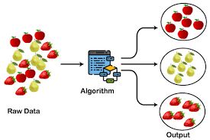
Today’s agenda
What is clustering (or cluster analysis)?
Task of grouping a set of objects in such a way that similar objects are in the same cluster
Unsupervised learning
Inferring knowledge from "unlabeled" data
Clustering algorithms
Distances between observations
K-Means clustering
Evaluation of clustering results
K-Medoids clustering (next week)
Hierarchical clustering (next week)
Summary (revisit learning outcomes)

Slide 12
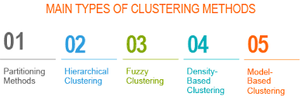

Slide 13
Unsupervised Learning
Cluster analysis is a type of unsupervised learning
Unsupervised learning: Draw inferences from datasets consisting of input data without labeled responses.
It is more subjective than supervised learning
There is no simple goal for the analysis, such as prediction of a response.
There are many cognitive issues that can affect the results. Examples
Confirmation bias
Texas sharpshooter fallacy
Bandwagon effect and etc.
I will try to make it as objective as possible
Evaluation of clustering
Determining the number of clusters: We don’t even know how many clusters are there in the data
Measuring clustering quality: There are different ways to measure clustering quality based on distance measures.
Why don’t we use out-of-sample testing?
Notes:
Examples:
Anomaly and Outlier detection
Principal component analysis

Slide 14
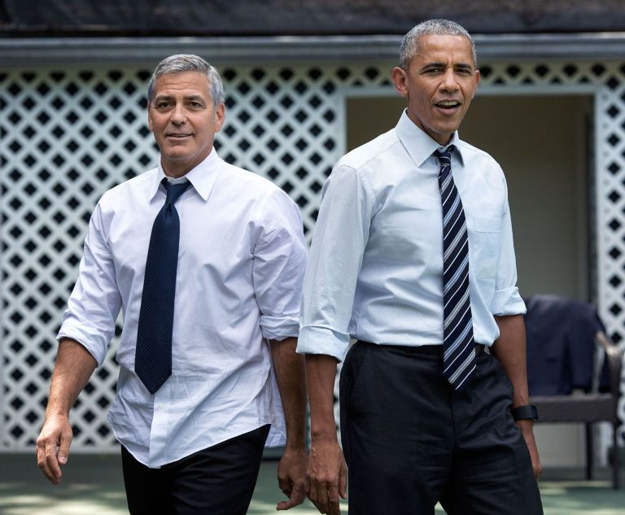
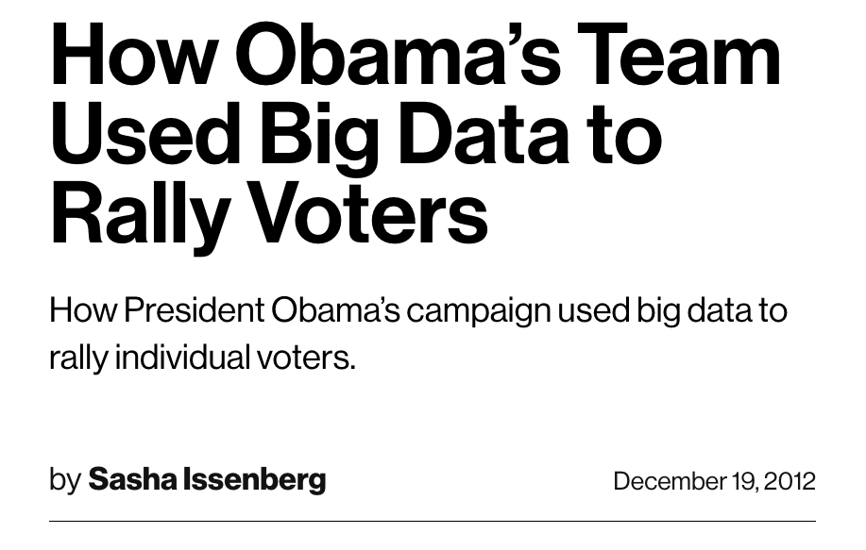
Motivation
Example: Obama election campaign
Identify target groups:
Goal: Registration, persuasion, and turnout.
Each target group has different characteristics
Identify democrat leaning group and convince them to vote
People were sent messages on Facebook to click a button to automatically urge those targeted voters to take certain actions, such as registering to vote, voting early or getting to the polls.
The campaign found that roughly 1 in 5 people contacted by a Facebook pal acted on the request, in large part because the message came from someone they knew.
Identify undecided and convince them to vote democratic
Identify subgroups within these groups based on their demographic info and produce targeted marketing campaigns.
They were able to put their target voters through some really complicated modelling, to say, if Miami-Dade women under 35 are the targets, [here is] how to reach them.”
For example they noticed that George Clooney had an almost gravitational tug on West Coast females aged 40 to 49. How do you think they used this information?

Slide 15
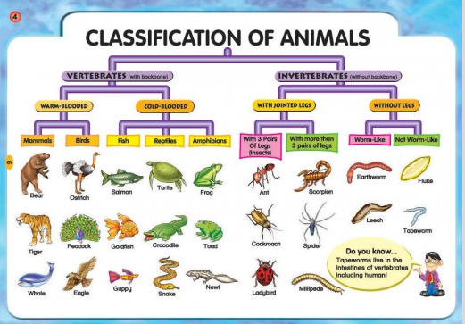
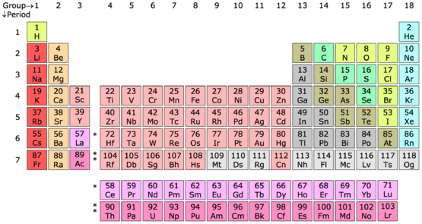
Clustering
Clustering is the process of grouping a set of data objects into multiple groups or clusters so that objects within a cluster have high similarity but are very dissimilar to objects in other clusters.
Dissimilarities and similarities are assessed based on the attribute values describing the objects and often involve distance measures.
Other applications:
Chemistry: Periodic table
Biology: Taxonomy

Slide 16
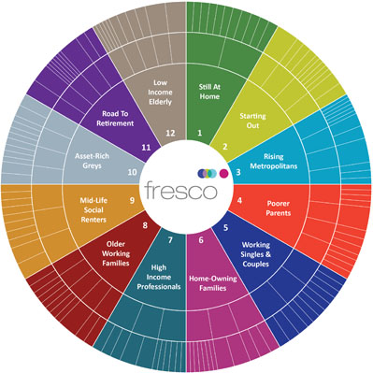
Motivation
Marketing
A large set of data is available for income, occupation and so on for a large number of people
Market segmentation: Identify subgroups of people who might be more receptive to a particular form of advertising or more likely to purchase a particular product.
The task of performing market segmentation amounts to clustering the people in the data set

Slide 17
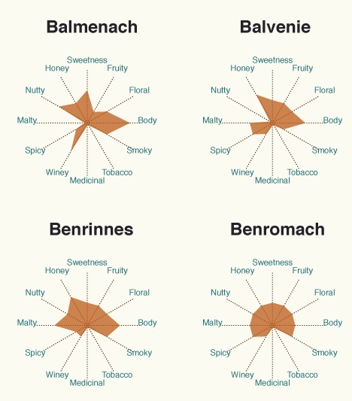
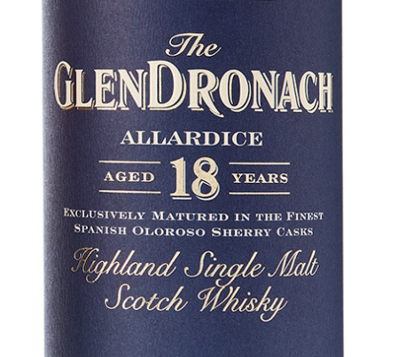
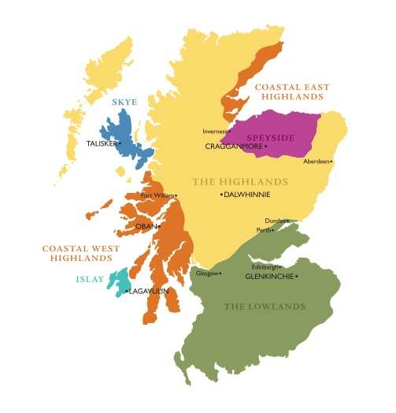
Whisky analytics
What are the major types of single-malt whiskies that can be recognized?
What are their chief characteristics and the best representatives?
What is the geographic component in that classification?

Slide 18
Whisky analytics
Goal: Identify clusters in whiskies from 86 distilleries based on tasting notes
Techniques: Use K-means, Partitioning around mediods (PAM), and Hierarchical clustering methods
Applications: Recommendation engines and hypothesis “testing”.

Slide 19
Clustering algorithms
Partitioning methods: K-means clustering
Partition a set of objects into k clusters in the best way possible.
We seek to partition the observations into a pre-specified number of clusters
Iterative approach to determine the “best way” possible.
Partitioning Around Medoids (PAM)
Hierarchical clustering
Start with all observations in separate clusters and successively merge the objects or groups close to one another
Evaluate the clusters by looking at the groups at different stages of the process(graphical approach)

Slide 20
K-Means Clustering
In K-means clustering, we seek to partition the observations into a pre-specified number of clusters
For example consider the following synthetic data points. (see next slide)
Each data point has two attributes x1 and x2
If I want to have two clusters the figure in the middle is what I end up with
If I want three it is the one on the right
Let’s focus on K=2. How do you think we should divide the points between two clusters?
We want disjoint sets; a point can belong to only one set
We want all points covered; each point has to belong to a point
We want the points to in the same cluster as similar as possible
How do I measure similarity? We use within cluster variation.

Slide 21
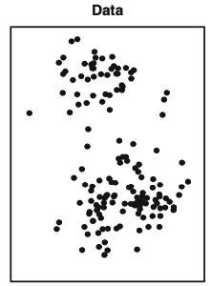
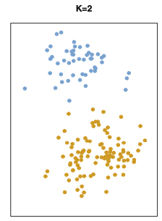
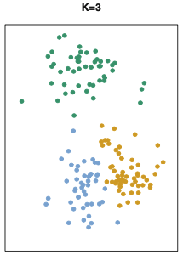
K-Means Clustering
We can formulate this as an optimization problem for fixed K.
Minimize within cluster variation
Subject to: All points should be assigned to one and only one cluster
X2
(Floral)
X1 (Tobacco)

Slide 22
Optimization formulation

Slide 23

K-Means Clustering
How do we define within cluster variance?
We use the sum of squared error for each observation.
How much error would I make if I estimate each variable of an observation by the average of these variables among all the observations in the same cluster?
Assume that the following observations are assigned to the same cluster
Total variation in this cluster = ${\left(3−4\right)}^{2}+{\left(5−4\right)}^{2}+{\left(1−2\right)}^{2}+{\left(3−2\right)}^{2}$
=4
What happens when we assign another observation to this cluster?
The mean changes hence the variance
Whisky | Tobac | Floral
a | 3 | 1
b | 5 | 3
Average | 4 | 2

Slide 24
K-Means Clustering Algorithm
The clustering problem becomes an optimization problem
Minimize total within cluster variation (K is fixed)
Subject to: All points should be assigned to one and only one cluster
It turns out this optimization problem is too difficult to solve in a reasonable time, hence we have an algorithm which tries to find good solutions.
K-Means clustering algorithm
Choose # of clusters desired, k
Start with a partition into k clusters (Often based on random selection of k centroids)
2a. Re-compute centroids (average for each variable within a cluster)
2b. At each step, move each record to cluster with closest centroid
Stop when moving records increases within-cluster dispersion
See next slide for a demonstration of this algorithm.

Slide 25
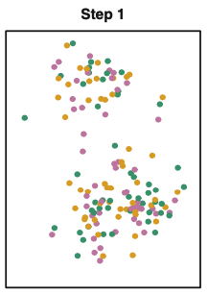
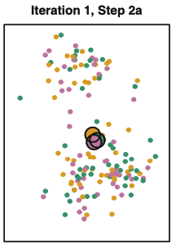
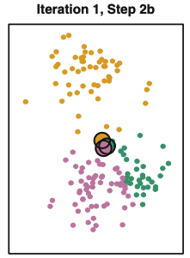
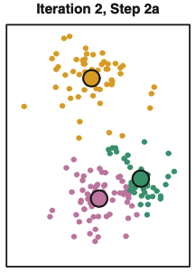
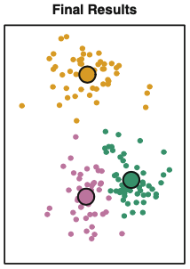
K-Means Clustering Algorithm
……….

Slide 26


Slide 27
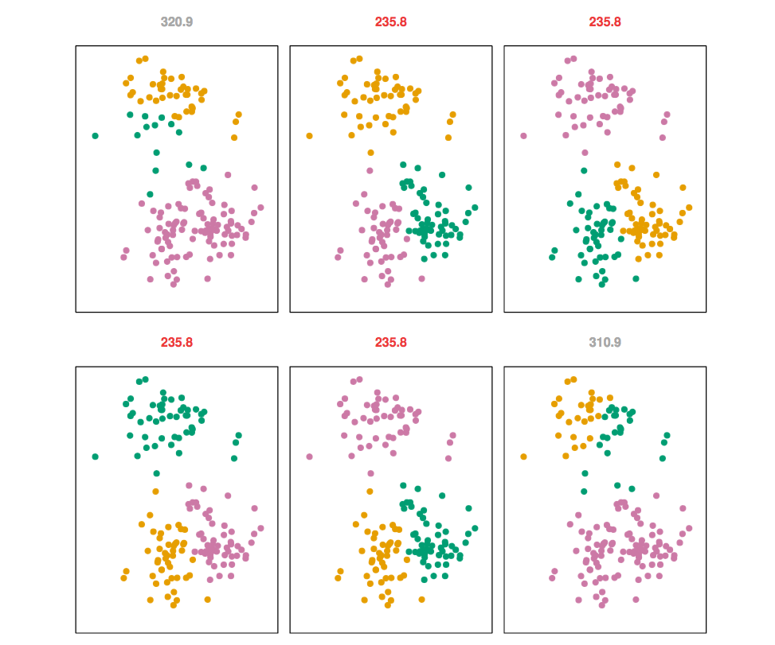
Example
Results of K-Means with six different starting points

Slide 28
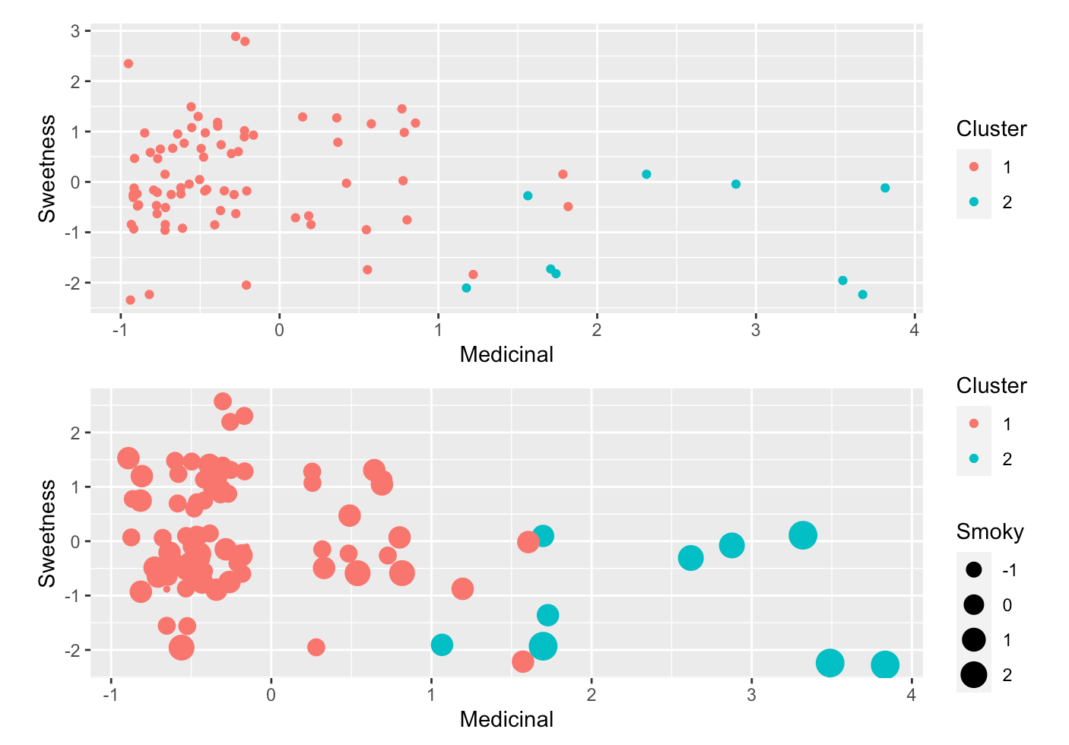
Example: Whisky Data
Visualizing based on features
Note, the small sample size for one group will not give us reliable clusters
There will always be border cases – in some clustering approaches you can have mutually non-exclusive groups

Slide 29
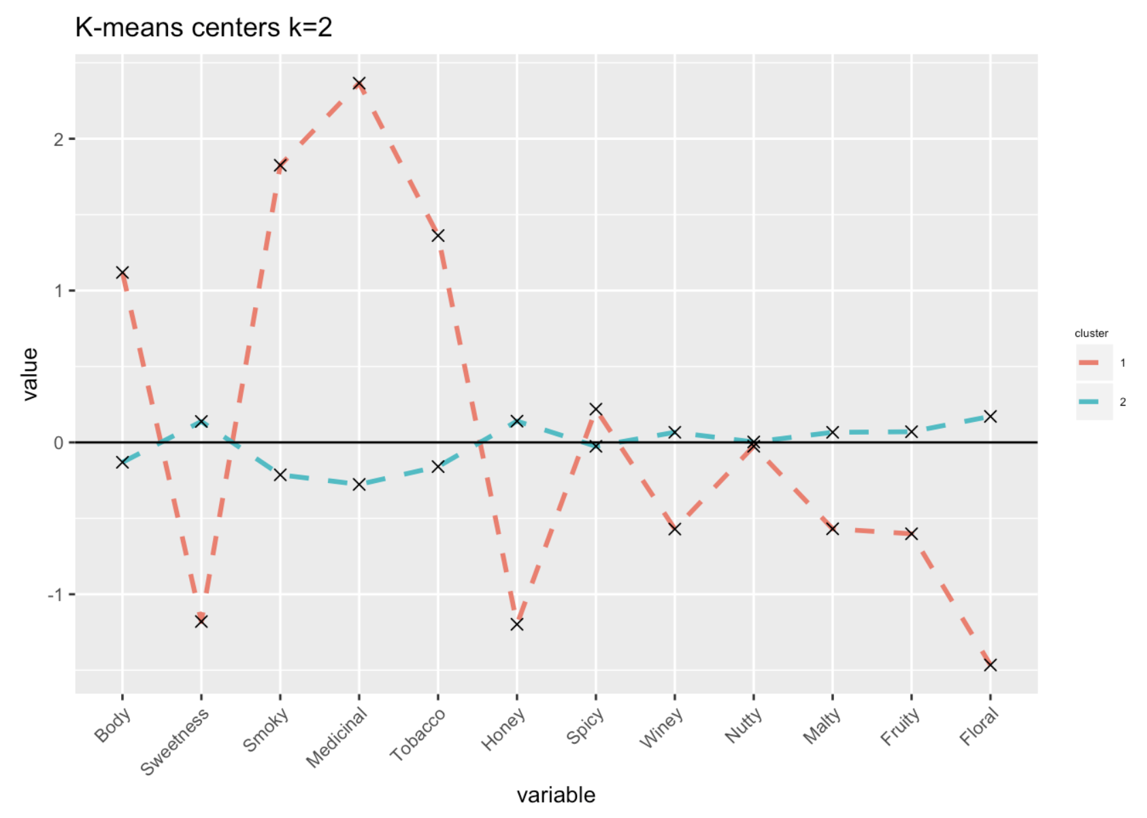
Example: Whisky Data
Visualizing based on centers

Slide 30
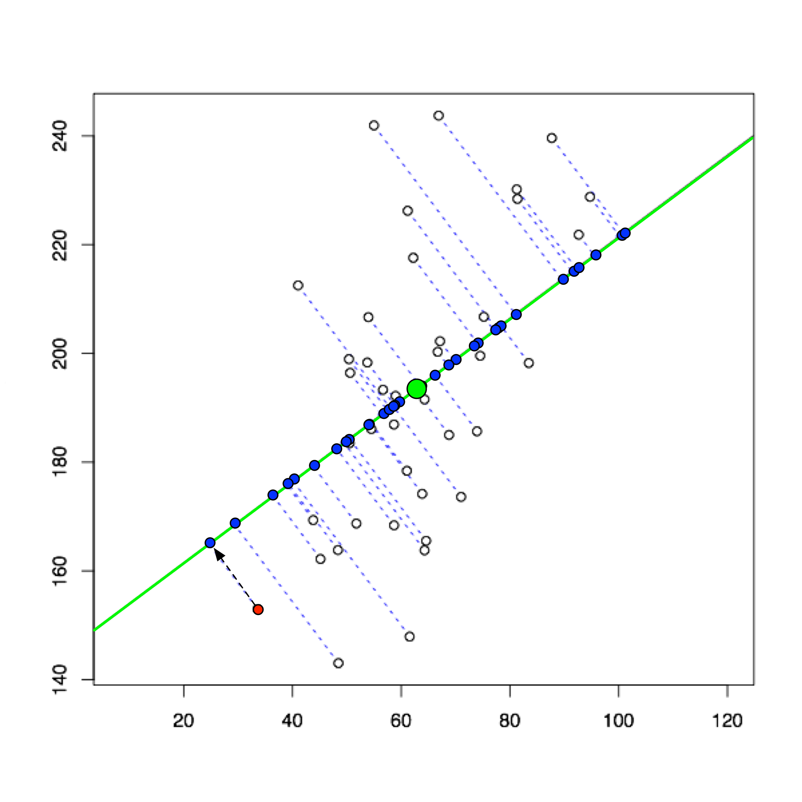
Example: Whisky Data
Visualizing Principal Components

Slide 31
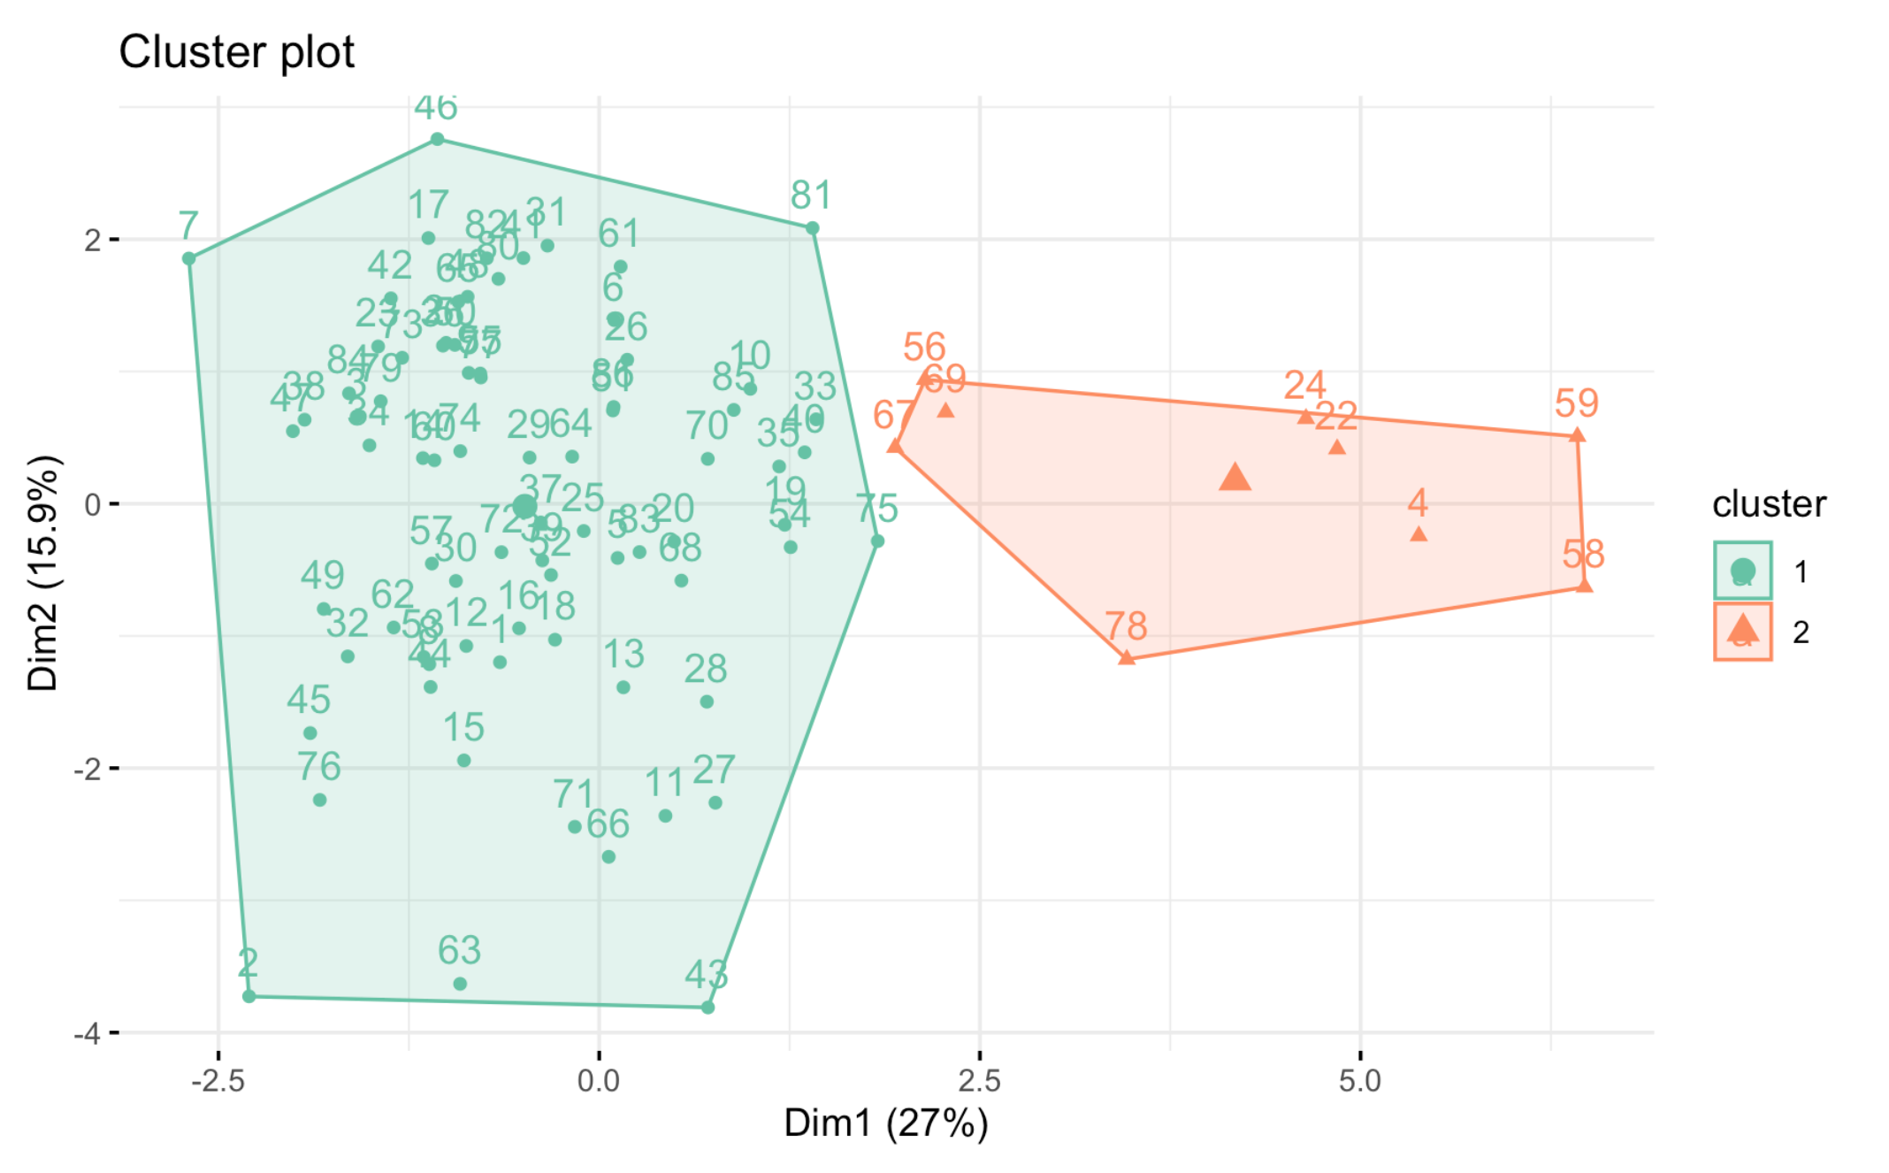
Example: Whisky Data
Visualizing Principal Components

Slide 32
Validating Clusters: Interpretation
How can we evaluate whether the clustering results are good?
Goal: obtain meaningful and useful clusters
Obtain summary statistics
Example: Clustering for marketing
Identifiability: refers to the extent that managers can recognize segments in the marketplace
Sustainability: criterion is satisfied if the segments represent a large enough portion of the data to ensure profitable customization of the marketing program.
Accessibility: The extent to which managers can reach the identified segments through their marketing campaigns is captured
Actionability: whether customers in segment and the marketing mix necessary to satisfy their needs are consistent with the goals and core competencies of the firm
Caveats:
(1) Random chance can often produce apparent clusters
(2) Different cluster methods produce different results
Notes:
dentifiability, sustainability, accessibility, and actionability.1 Identifiability refers to the extent that managers can recognize segments in the marketplace. In the Geico example, the profiling of customers allows us to identify customer segments through their age and income information. PRIZM and ACORN are popular databases that provide geo- demographic information that can be used for segmentation as well as profiling. The sustainability criterion is satisfied if the segments represent a large enough portion of the market to ensure profitable customization of the marketing program. The extent to which managers can reach the identified segments through their marketing campaigns is captured by the accessibility criterion. Finally, actionability refers to whether customers in segment and the marketing mix necessary to satisfy their needs are consistent with the goals and core competencies of the firm. The success of any segmentation process therefore requires managerial intuition and careful judgment.

Slide 33
Visualizing clusters: Summary
We can check how points are clustered by plotting locations of each observation vs two of the variables (maybe three)
If there are many dimensions, this is not very useful
We can use dimension reduction and plot the points as explained above. But this lacks interpretability
PCA will be covered in your Machine Learning Class
I will just show you how it plays out in cluster visualization
We can visualize the centers of the clusters

Slide 34
Determining the number of clusters
Elbow method
Visualization
Silhouette method
NbClust() function: 30 indices for choosing the “optimal” number of clusters

Slide 35
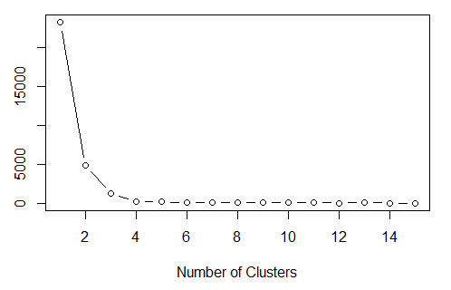
Number of clusters: Elbow plot
Look for a bend or elbow in the sum of squared error (SSE) scree plot.
On the example on top plot, 3 or 4 seems to be reasonable
Can total variation within cluster increase with # of clusters?
How many clusters do you need in the second case?

Slide 36
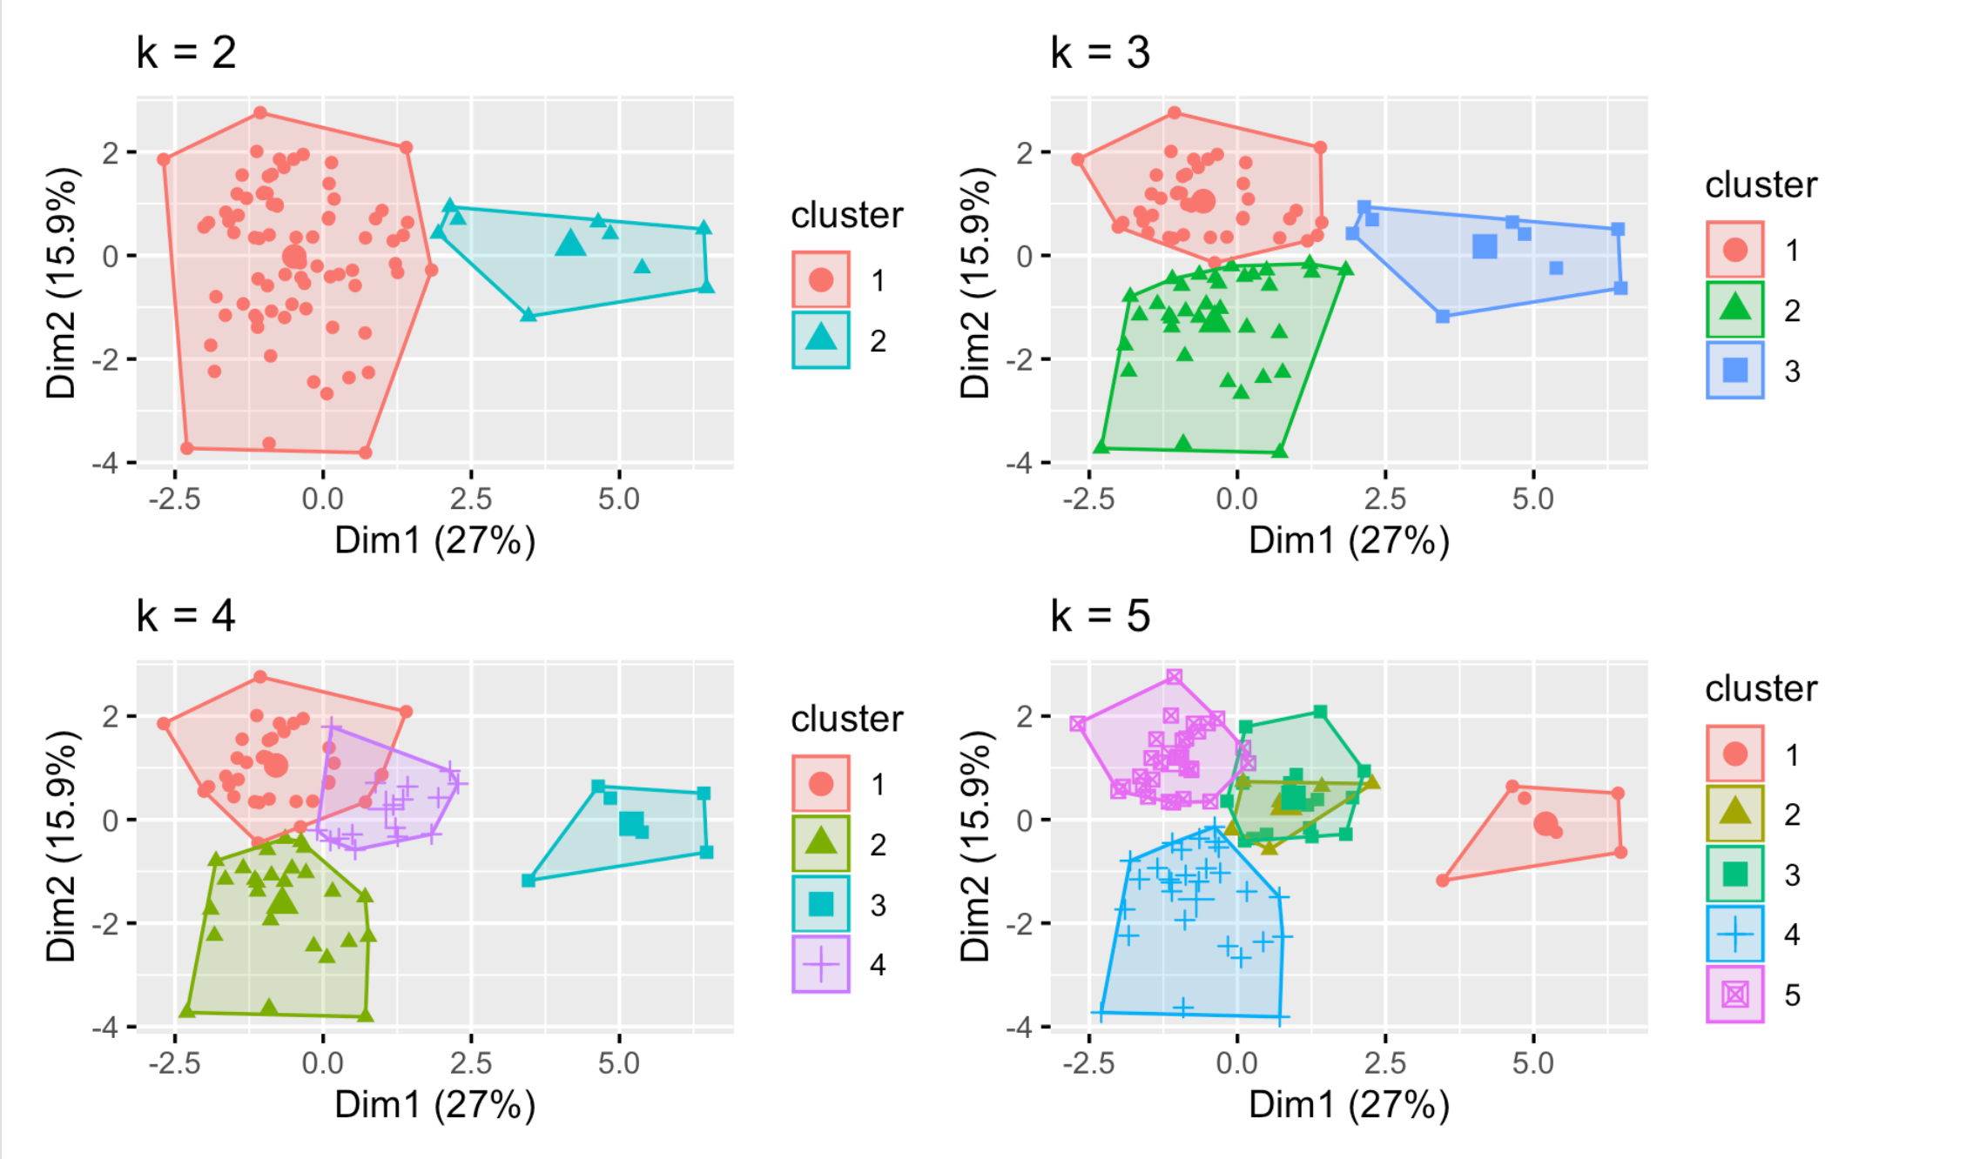
Visualizing clusters
6

Slide 37
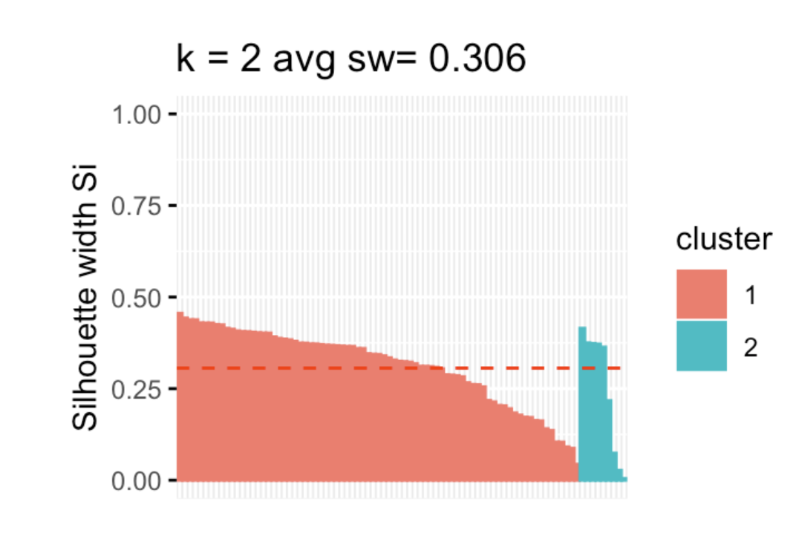
Silhouette Analysis

Slide 38

Silhouette Analysis
SA refers to a method of interpretation and validation of consistency within clusters of data.
Its a neat way to find out the optimum value for k during k-means clustering.
The silhouette value is a measure of how similar an object is to its own cluster (cohesion) compared to other clusters (separation).
$$s(i)=\frac{N\left(i\right)−C(i)}{max⁡(C\left(i\right),N\left(i\right))}$$
See next slide for definitions
The silhouette ranges from −1 to +1, where a high value indicates that the object is well matched to its own cluster and poorly matched to neighboring clusters.
If most objects have a high value, then the clustering configuration is appropriate.
If many points have a low or negative value, then the clustering configuration may have too many or too few clusters.
Mean Silhouette score: Mean score can be simply calculated by taking the mean of silhouette score of all the examples in the data set. This gives us one value representing the Silhouette score of the entire cluster.

Slide 39


Silhouette Analysis
For each data point $i∈C_{i}$ data point $i$ in the cluster $C_{i}$, define in cluster distance as
$$C\left(i\right)=\frac{1}{\left|C_{i}\right|−1}\sum_{j∈C_{i},i≠j}{d(i,j)}$$
For each data point $i∈C_{i}$, define distance to the nearest neighbor as
$$N\left(i\right)=\min_{k≠i}{\frac{1}{\left|C_{k}\right|}}\sum_{j∈C_{k}}{d(i,j)}$$
The silhouette s(i) for point i is
$$s(i)=\frac{N\left(i\right)−C(i)}{max⁡(C\left(i\right),N\left(i\right))}$$

Slide 40
C(i) is the average distance of point 'i' with all other points within the same same cluster
N(i) is the average distance of point 'i' with all points in the closest cluster
S(i) is the SA coefficient

Slide 41
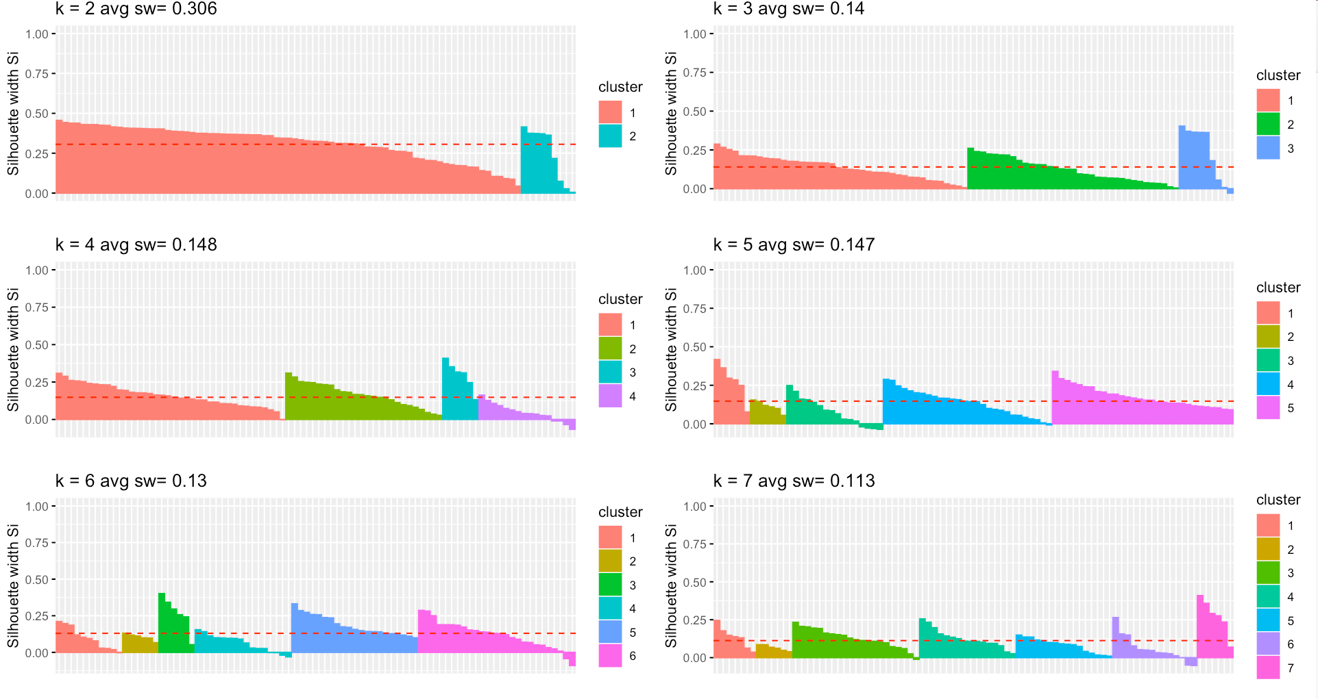
Silhouette Analysis

Slide 42
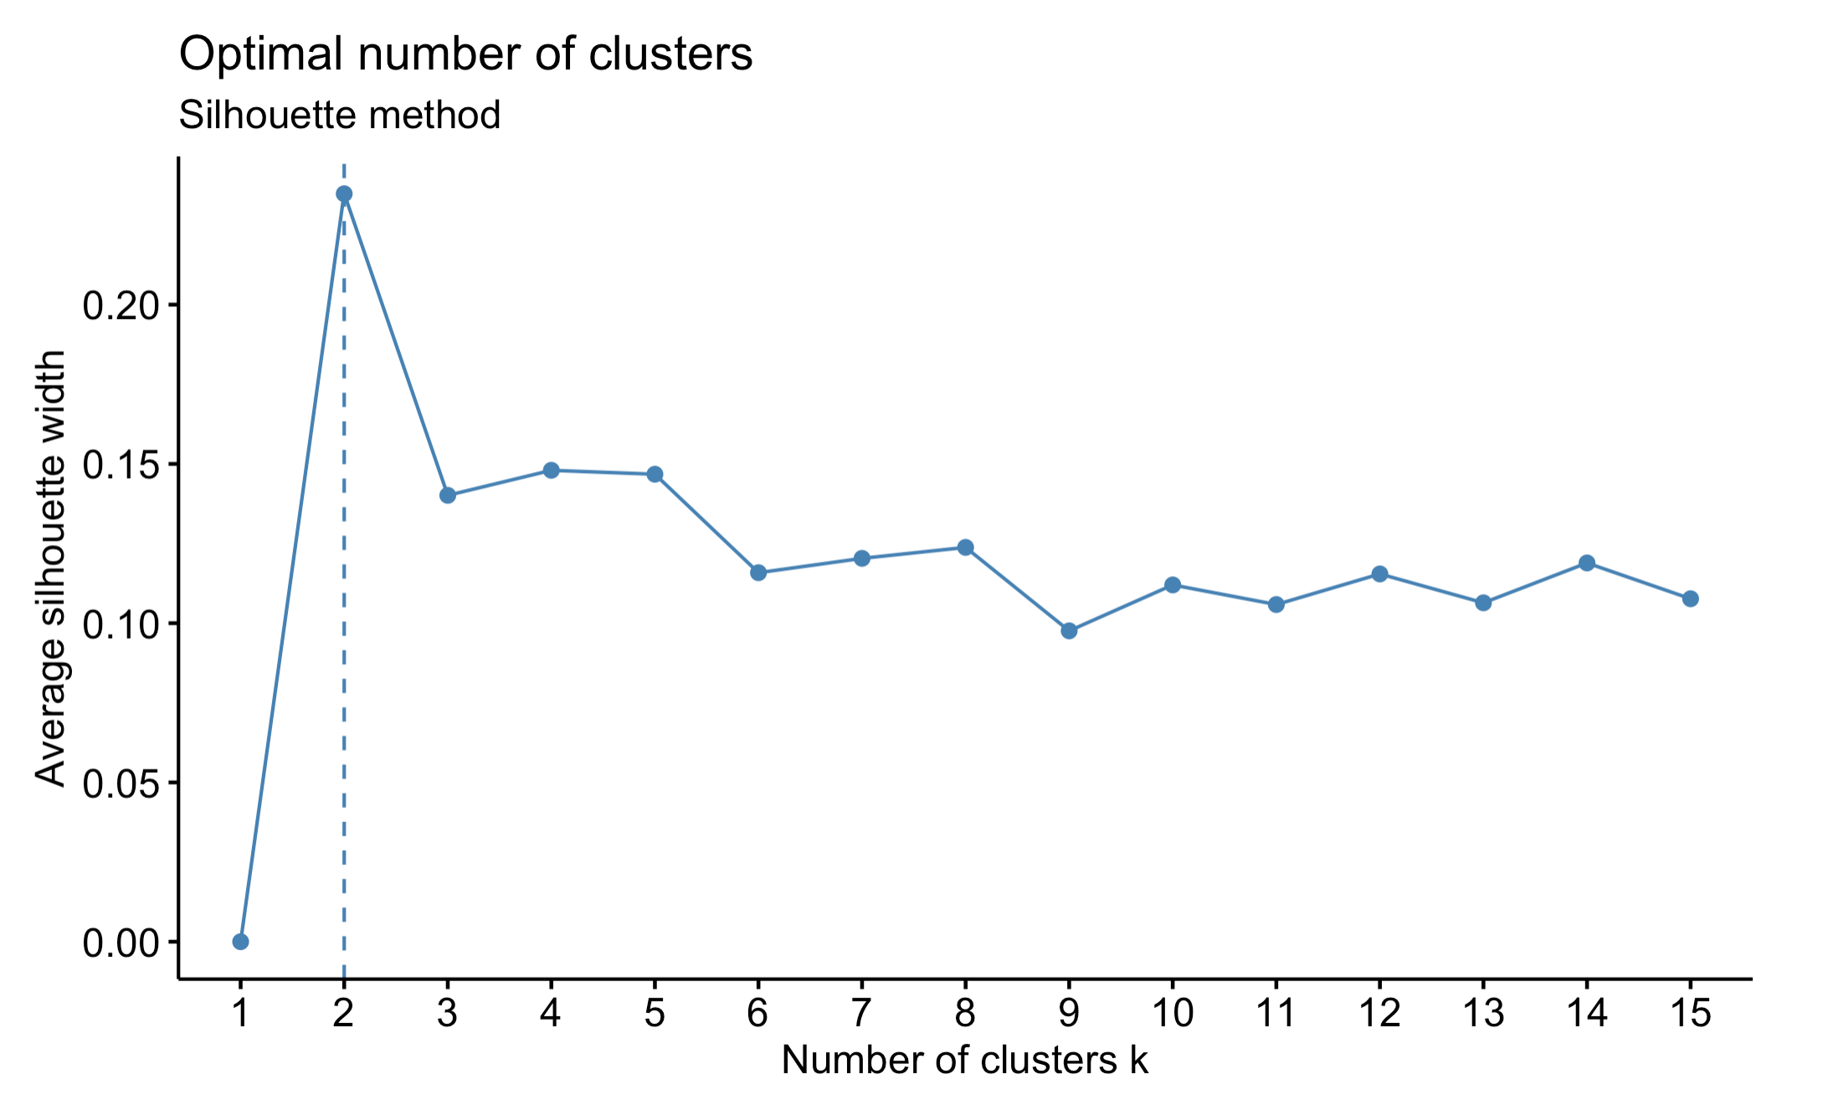
Silhouette Analysis

Slide 43
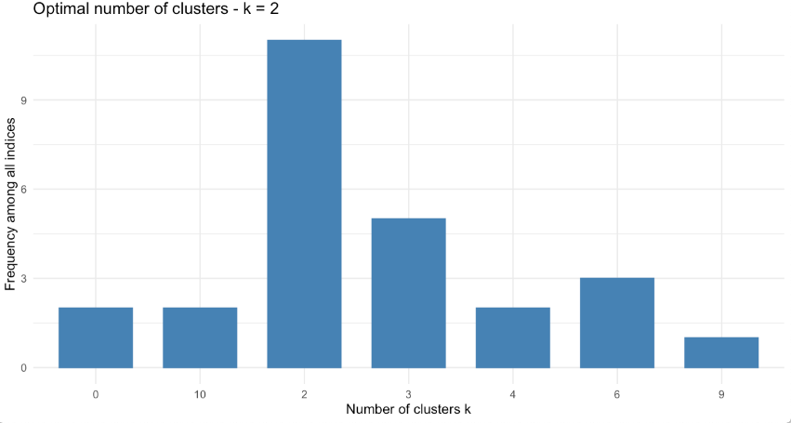
NBClust
There are many more
NbClust package provides 30 indices for determining the number of clusters and proposes to user the best clustering scheme from the different results obtained by varying all combinations of number of clusters, distance measures, and clustering methods.

Slide 44
Clustering steps
Once you clean the data start by clustering data into a few clusters, 2 or 3 are good starting points
Check how many points are in each cluster
Small clusters are usually not very useful
Visualize PCA to verify separation
Plot the means of clusters to detect differences between clusters
Think about variables that may not be very critical for clustering purposes or think about eliminating those that are highly correlated.
Increase the number of clusters and check how that changes clustering results
Use elbow chart and silhouette analysis (there are also other methods) to verify the number of clusters you are using are not way off
Don’t use these methods blindly. Their results only provide guidance but not definitive answers.

Slide 45
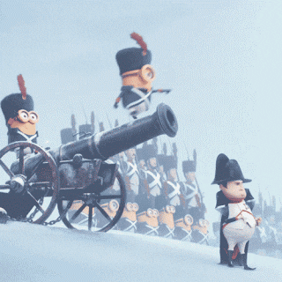
Summary
Cluster analysis is an exploratory tool. Useful only when it produces meaningful clusters
We usually use a few methods to verify the accuracy of our conclusions.
Be wary of chance results; data may not have definitive “real” clusters- Texas sharpshooter fallacy
Notes:
https://www.youtube.com/watch?v=d_CaZ4EAexQ
Swedish study in 1992 tried to determine whether power lines caused some kind of poor health effects. The researchers surveyed everyone living within 300 meters of high-voltage power lines over a 25-year period and looked for statistically significant increases in rates of over 800 ailments. The study found that the incidence of childhood leukemia was four times higher among those who lived closest to the power lines, and it spurred calls to action by the Swedish government.^{[6]} The problem with the conclusion, however, was that the number of potential ailments, i.e. over 800, was so large that it created a high probability that at least one ailment would exhibit the appearance of a statistically significant difference by chance alone; ie. the multiple comparisons problem. Subsequent studies failed to show any links between power lines and childhood leukemia, neither in causation nor even in correlation.^{[7]}

Slide 46
Learning objectives
Conclusions
What is the difference between supervised and unsupervised learning?
What is the main objective of clustering?
How does K-Means algorithm work?
Objective
Inputs
Outputs
How do we determine how many clusters we have in the data?
Elbow chart
PCA visualization
Comparing clustering results with different clusters
Silhouette analysis

Slide 47
K-means Algorithm: Issues
Results are sensitive to outliers (why?)
How to resolve this?
Use different distance measures such as absolute error
Use the median of observations instead of average.
Use K-Medoids (next)
K is fixed in advance
Use elbow charts and see when there is no improvement
The algorithm may end up in a local optimal
Re-start with different initial clusters and see if there is a big difference
The clusters are expected to be of similar size
Use other methods to verify the results (next)

